Slide 1
MALCOM Machine Learning for Communication Systems Lecture 1 Introductory Lecture: A Panoramic View Photios A. Stavrou Spring 2024

Slide 2
MALCOM
Wireless
Communication
Systems
Machine
Learning
Supervised Learning
Unsupervised Learning
Deep Learning
Reinforcement Learning
Physical Layer (PHY)
Data Link layer
MAC: medium access control
LLC: logical link control
Network Layer
Communication-efficient
Distributed Machine Learning
ML for Communication Systems & Communication for ML Systems
Notes:
Ajouter une photo d’un vieux telegraphe, puis un mobile satellitte ancienne generation…can someone find an even older wireless communication system (smoke)

Slide 3
The Course
Prerequisites
Probability, statistics, linear algebra, calculus
Basic notions of (convex) optimization
Lab sessions: Python, TensorFlow (Keras) – PyTorch welcome – MATLAB fine
What about: MALIS? Deep Learning? ComSys? InfoTheory?
What to expect?
Recap on key concepts and baseline techniques of ML (depends on class background)
Explore advanced and modern ML techniques
Learn fundamental and key theoretical concepts for AI/ML
Understand key aspects of distributed ML and ML over Wireless Networks
Be able to follow recent/SOTA developments in AI/ML
Understand the various opportunities and challenges of ML for communication systems
Mixture of theory, algorithms, and practical applications.
What NOT to expect?
Instantly becoming an expert data scientist or AI/ML/ComSys researcher
Learning “how to use a toolbox” or getting a laundry list of algos for ComSys, etc.
Teaching you python, pytorch, tensorflow, pandas, Hadoop, …
Notes:
Ajouter une photo d’un vieux telegraphe, puis un mobile satellitte ancienne generation…can someone find an even older wireless communication system (smoke)

Slide 4
Course Overview
Logistics
14 sessions: 11 lectures + 3 Lab sessions (1-2 lectures may be revisions)
Attendance to the lab is mandatory
Lab reports/notebooks are graded
No HWs but exercises will be solved in the class from time to time
Recap in the beginning of each lecture
Materials
No textbook required
Lecture slides and exercises solved in class
Suggested readings and online resources will be posted (feel free to ask for more!)
Assessment
Final Exam 70% (written)
Lab 30%
Project – optional (20% bonus)
Communication
Email: fotios.stavrou@eurecom.fr (responsible teacher),
Office: 315
Office hours: by appointment, just drop me an email to schedule a meeting (in-person or remote)
Notes:
Ajouter une photo d’un vieux telegraphe, puis un mobile satellitte ancienne generation…can someone find an even older wireless communication system (smoke)

Slide 5
Project
Types
Applied: implement ML algorithms and apply them to real-world problems and tasks
Algorithmic: develop a new ML algorithm or extend an existing algorithm
Theoretical: research-oriented, proving and assessing certain properties of an ML algorithm
Project Proposal
Find your project idea to work on
If you have a specific interest, I'd be happy to brainstorm and suggest some project ideas
Format: PDF document with:
Project title, team members names, & 300-500 word description of what you plan to do
Project description
Motivation: state the problem you will tackle
Method: present the ML technique you plan to use
Positioning: compare/position your project idea with respect to state of the art/existing work
Plan and intended work: state a workplan/timeline, identify key objectives and describe the methodology employed (algorithm, experiments, evaluation procedure, main outcome)
Proposal deadline: April 2st, 2024
Notes:
Ajouter une photo d’un vieux telegraphe, puis un mobile satellitte ancienne generation…can someone find an even older wireless communication system (smoke)

Slide 6
Tentative Schedule
Lecture 1: Introductory lecture: A Panoramic View
Lecture 2: Key Concepts from Neural Networks (recap)
Lecture 3: Key Concepts from supervised ML (recap)
Lecture 4: Generative Models I: Autoencoders
Lecture 5: Neural Networks Implementation and Training (Lab 1)
Lecture 6: Information Theoretic Foundations in ML
Lecture 7: Generative Models II: GANs
Lecture 8: Large-Scale ML and Optimization
Lecture 9: Distributed ML, Edge AI/ML
Lecture 10: GANs (Lab 2)
Lecture 11: Communication-Efficient AI/ML and Federated Learning
Lecture 12: Federated Learning (Lab 3)
Lectures 13-14: Revision – Exam Preparation
Notes:
Ajouter une photo d’un vieux telegraphe, puis un mobile satellitte ancienne generation…can someone find an even older wireless communication system (smoke)

Slide 7
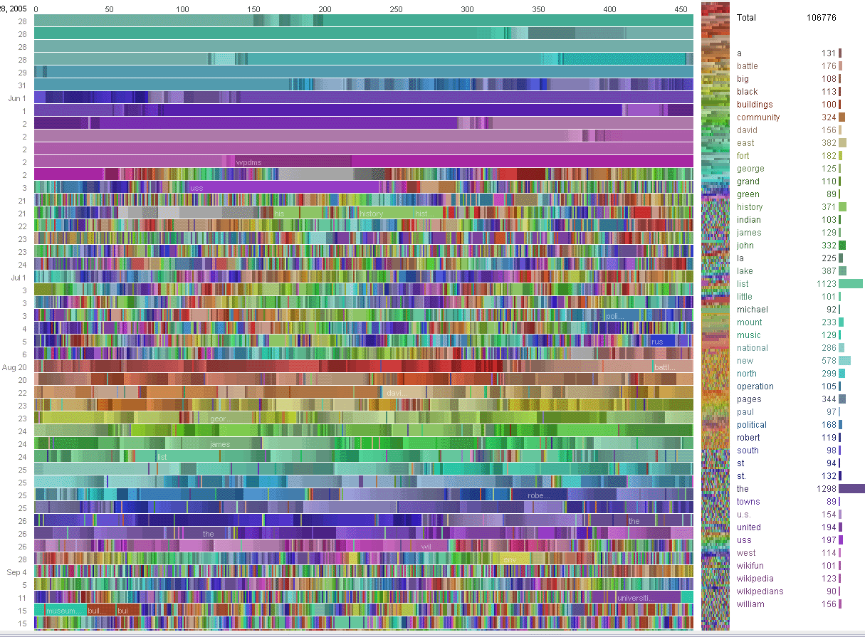

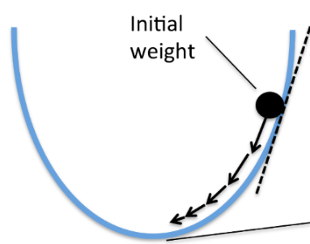
Machine Learning in a Nutshell
Algorithms that can efficiently
learn and generalize from data
Traditional approach (no ML)
Modeling
(math/physics)
Algorithms with
optimized design
performance guarantees (under given model)
Domain knowledge acquisition
Algorithm development
Machine learning approach (baseline)
Choose a general-purpose model or hypothesis class
Choose a loss function and an optimization procedure
Collect data (examples)
... and use of the trained (black-box) ML model for inference
Justify the accuracy of the estimate and adjust
Notes:
Ajouter une photo d’un vieux telegraphe, puis un mobile satellitte ancienne generation…can someone find an even older wireless communication system (smoke)

Slide 8
AI vs. ML vs. DNN vs. DS…
Artificial Intelligence (AI)
The science and engineering of making intelligent machines, especially computer systems by reproducing human intelligence through learning, reasoning and self-correction/adaption. [McCarthy89]
Machine Learning (ML)
A computer program (algorithm) that improves its performance measure P at some class of tasks T with experience E. [Mitchell90]
Field of study that gives computers the ability to learn without being explicitly programmed. [Samuel59]
Deep Learning (DL)
Deep learning allows computational models that are composed of multiple processing layers to learn representations of data with multiple levels of abstraction. [LeCun15]
Deep Learning (vs. ML)
DL extracts high-level features from complex data (almost no need for human design).
Lack of model interpretability (black box) - changing
Complex hyper-parameters tuning and time-consuming optimal configuration – sustainability?
Computationally demanding (need for GPUs++) – how to deploy on embedded or mobile devices?
A. Samuel, "Some Studies in Machine Learning Using the Game of Checkers". IBM Journal of Research and Development. 3 (3), 1959.
T. Mitchell, B. Buchanan, G. DeJong, T. Dietterich, P. Rosenbloom, A. Waibel, Machine learning, Annual review of computer science 4 (1) (1990) 417–433.
J. McCarthy, Artificial intelligence, logic and formalizing common sense, in: Philosophical logic and artificial intelligence, Springer, 1989, pp. 161–190.
Y. LeCun, Y. Bengio, G. Hinton, Deep learning, nature 521 (7553) (2015) 436.
Notes:
Ajouter une photo d’un vieux telegraphe, puis un mobile satellitte ancienne generation…can someone find an even older wireless communication system (smoke)

Slide 9
What about Data Science?
Data science = extract/extrapolate knowledge and uncover actionable insights from data
Data Exploration and Preparation
Sanity check of data basic properties, anomalies, and artifact remediation
grouping, smoothing subsetting, etc.
Data Representation and Transformation
Combining data from different databases with different formats and mathematically representing special type of data using transformations (e.g., Fourier, wavelet)
Computation
Data R (tidyr, dplyr, ggplot2), Python (Pandas, Scikit-learn, NumPy, matplotlib), Java, C++, Git/GitHub, Hadoop and MapReduce for parallel computing, HPC clusters, …
Modeling
Generative modeling
Predictive modeling
Data Visualization and Presentation
Notes:
Ajouter une photo d’un vieux telegraphe, puis un mobile satellitte ancienne generation…can someone find an even older wireless communication system (smoke)

Slide 10
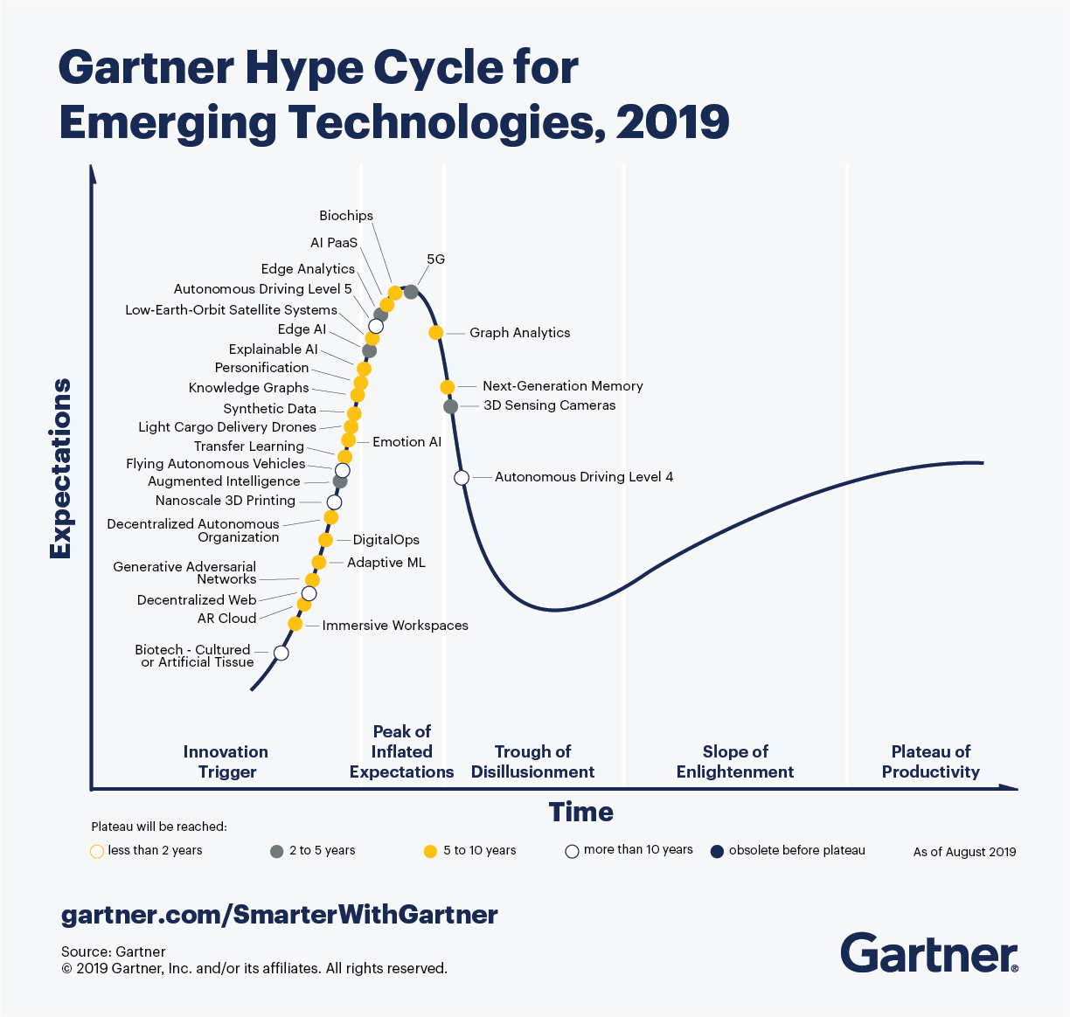
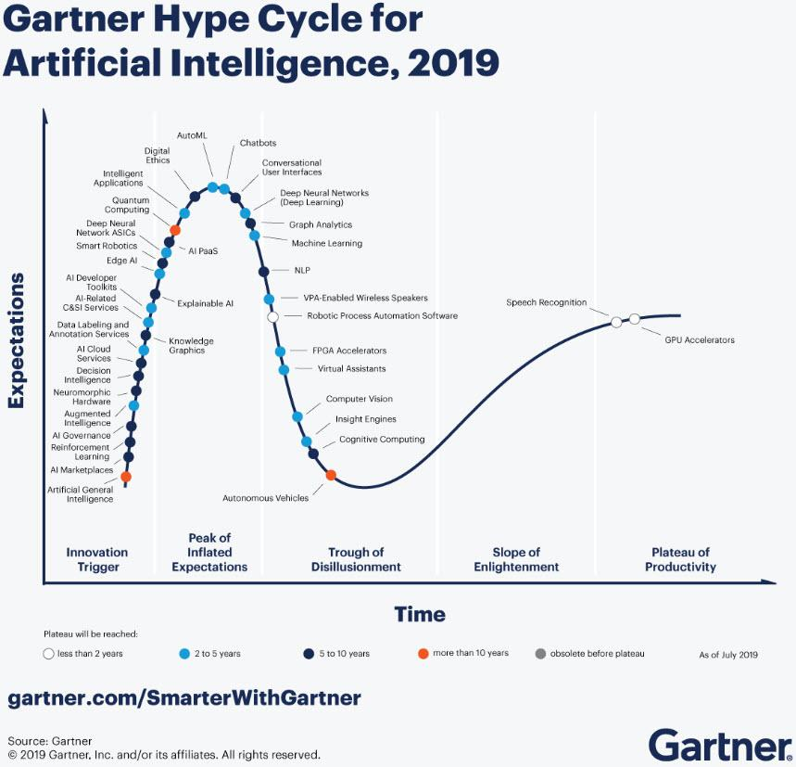
Hype or Hope?
Emerging Techs
AI
Source: Gartner
AI entered in the hype cycle in 2010
Organizations deploying AI grew from 4% to 14% in 1 year
New entry in 2019: Edge AI (2nd part of this course)
Notes:
Ajouter une photo d’un vieux telegraphe, puis un mobile satellitte ancienne generation…can someone find an even older wireless communication system (smoke)

Slide 11
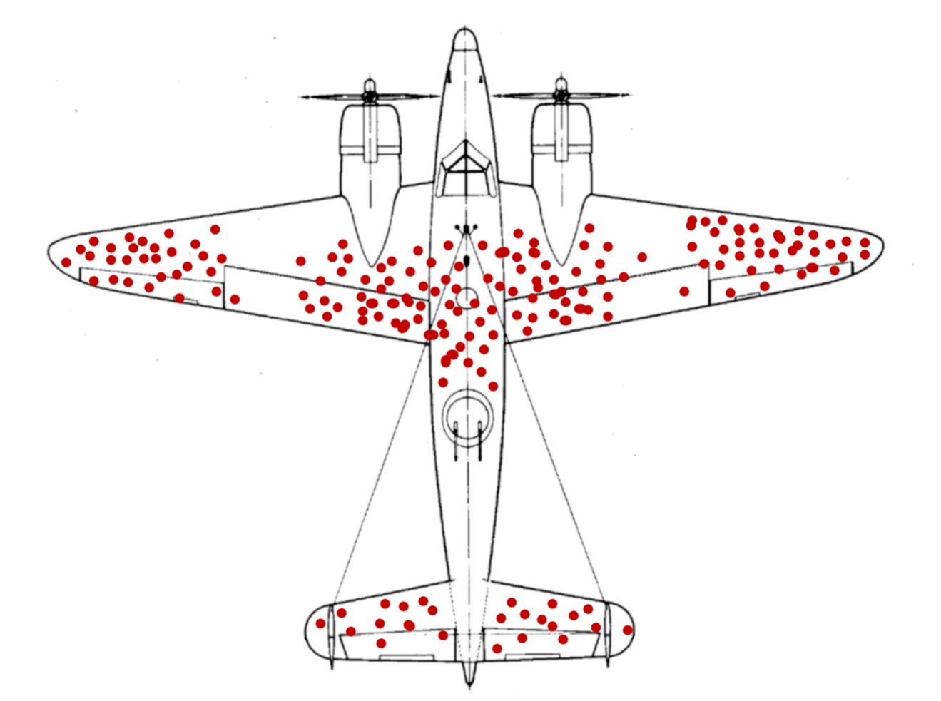
Is Data-Driven approach new?
During World War II, the British Royal Air Force estimated the density of bullet holes on different sections of planes returning to base from aerial sorties.
Their goal was to use this information to determine which plane sections most needed additional protective shields.
They found that the density of holes was highest on the wings and lowest on the engines and near the cockpit, where the pilot sits
Initial conclusion: wings should be reinforced
What is the main problem with the sample: bias or large sampling error?
What part of the plane should have been reinforced?
A. Wald: Selection or survivor bias!
Beware of insufficient data and a biased view of the information given
Source: McGeddon, “Survivorship Bias,” 2019.
Notes:
Ajouter une photo d’un vieux telegraphe, puis un mobile satellitte ancienne generation…can someone find an even older wireless communication system (smoke)

Slide 12
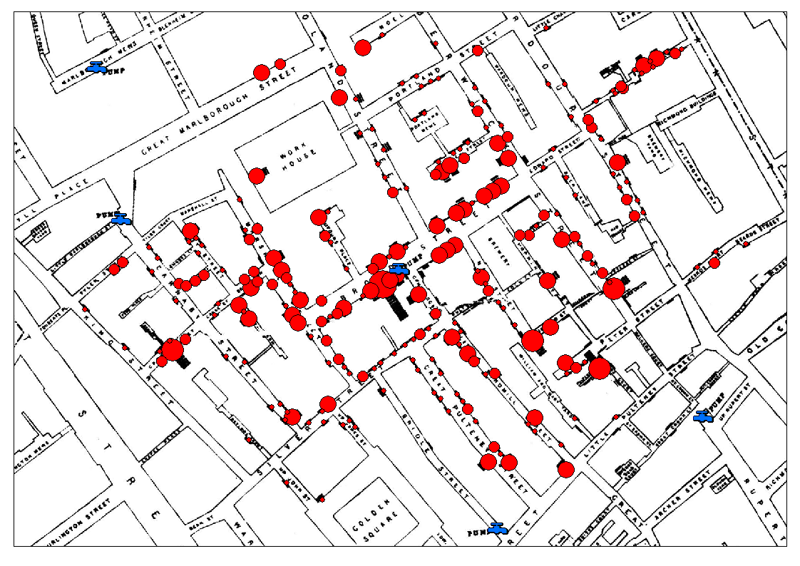
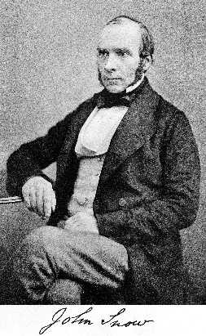
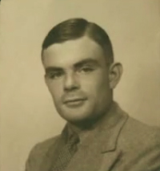
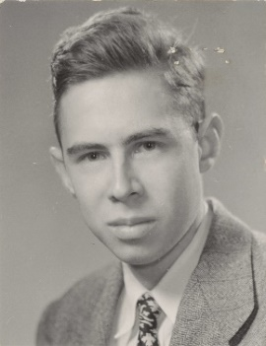
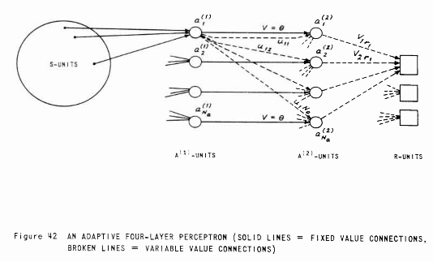
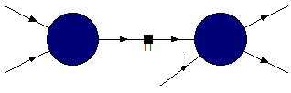
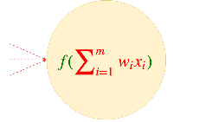
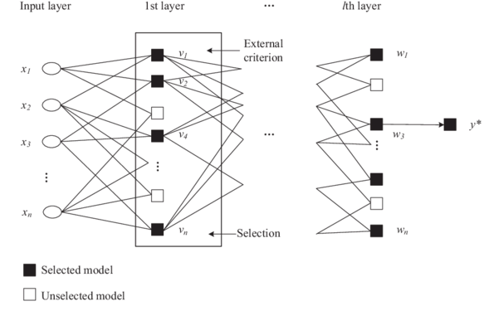
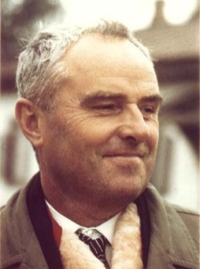
Is ML new ?
Cholera outbreak (Broad Street, London 1854)
The power of data
significant correlation between street-pumps and cholera deaths
Alan Turing
“Intelligent Machinery” (1948, NPL Report)
Turing’s B-type Neural Networks
Frank Rosenblatt
Perceptron (1957)
Alexey Ivakhnenko
GMDH (1969)
Cybernetic Predicting Devices
1st working Deep Learners with many layers, learning internal representations.
A.G.Ivakhnenko and V.G. Lapa (1965).
Group Method for Data Handling
8-layer NN training in 1971
Notes:
Ajouter une photo d’un vieux telegraphe, puis un mobile satellitte ancienne generation…can someone find an even older wireless communication system (smoke)

Slide 13
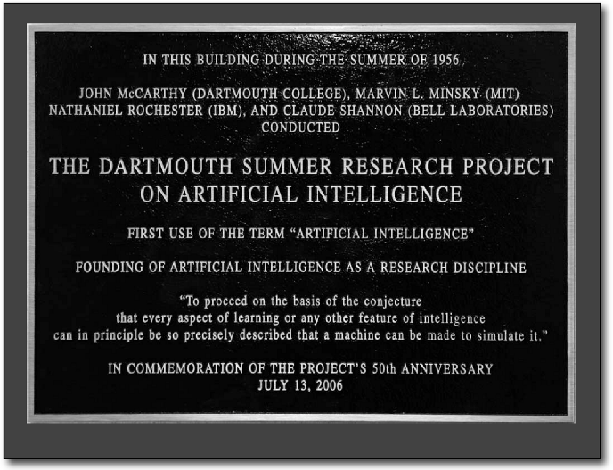
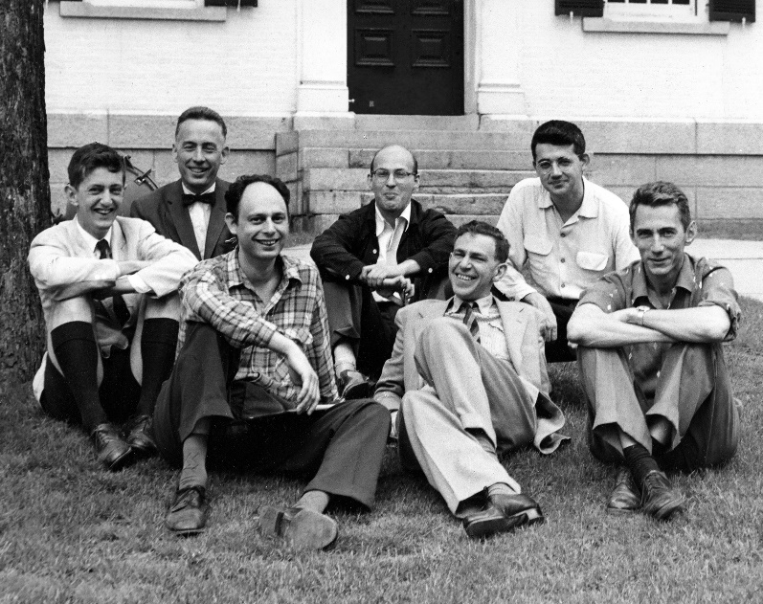
Is AI new ?
1956 Dartmouth Summer Research Project on Artificial Intelligence
C. Shannon (front right), J. McCarthy (back right), M. Minsky (center), R. Solomonoff (front left), and N. Rochester (back left).
Notes:
Ajouter une photo d’un vieux telegraphe, puis un mobile satellitte ancienne generation…can someone find an even older wireless communication system (smoke)

Slide 14
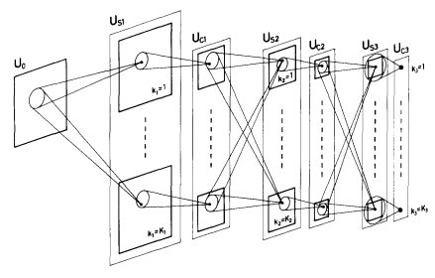
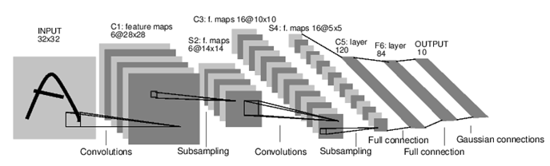
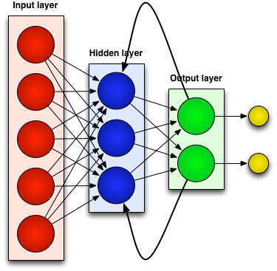
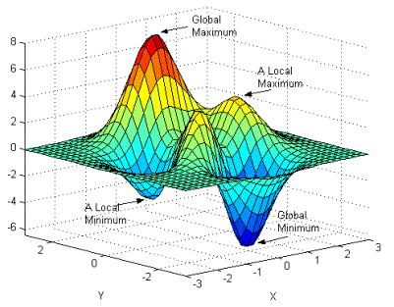
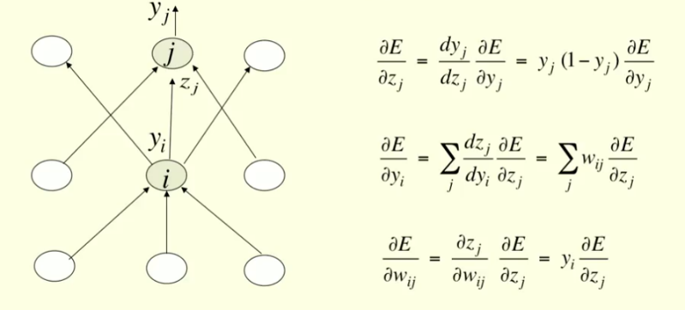
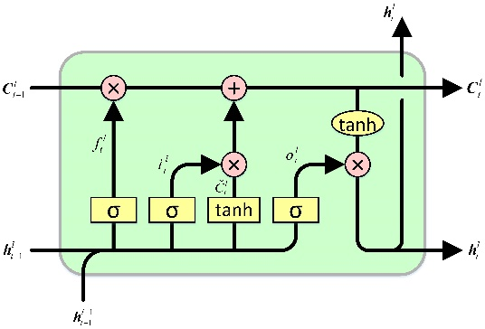
Waking up …
CNN LeNet (LeCun, 1989)
Neocognitron (Fukushima, 1979)
RNN (Rumelhart, 1986)
Deep Neural Networks & Backpropagation
(LeCun, Bengio, etc., mid 80s)
LSTM (Hochreiter and Schmidhuber, 1997)
Notes:
Ajouter une photo d’un vieux telegraphe, puis un mobile satellitte ancienne generation…can someone find an even older wireless communication system (smoke)

Slide 15
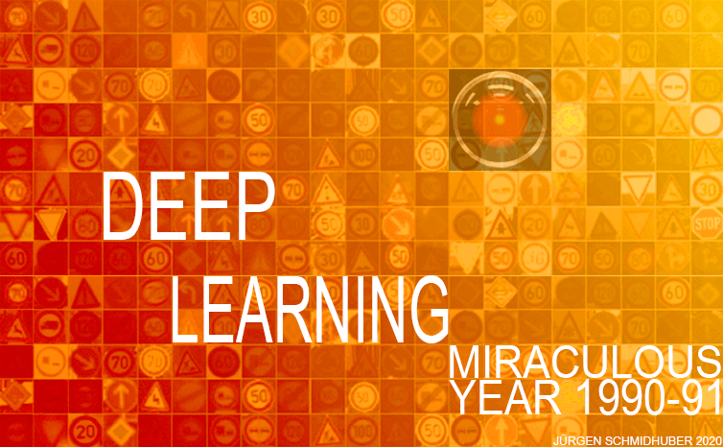
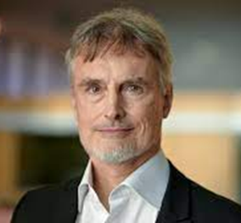
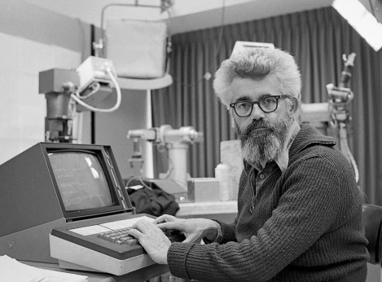
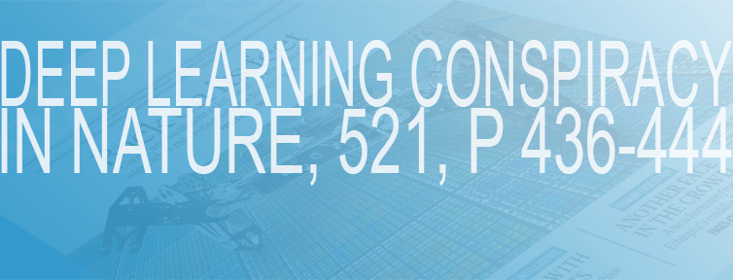
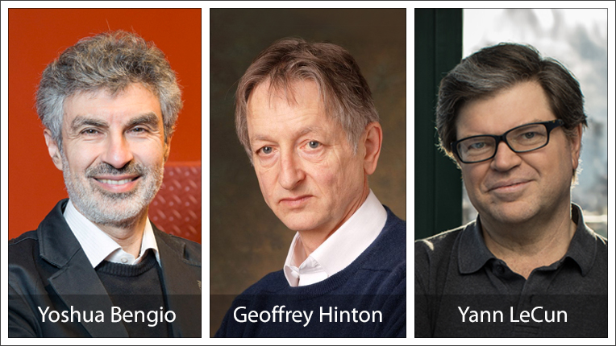

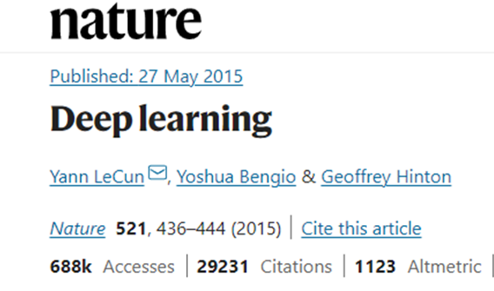
On “Fatherhood”
Jürgen Schmidhuber
https://people.idsia.ch//~juergen/deep-learning-miraculous-year-1990-1991.html
ArXiv Paper: https://arxiv.org/abs/2005.05744
https://people.idsia.ch/~juergen/deep-learning-conspiracy.html
John McCarthy
2018 ACM Turing Award
(“Nobel of Computing”)
Alexey Grigorevich Ivakhnenko (1913-2007)
(Олексíй Григо́рович Іва́хненко)
Notes:
Ajouter une photo d’un vieux telegraphe, puis un mobile satellitte ancienne generation…can someone find an even older wireless communication system (smoke)

Slide 16
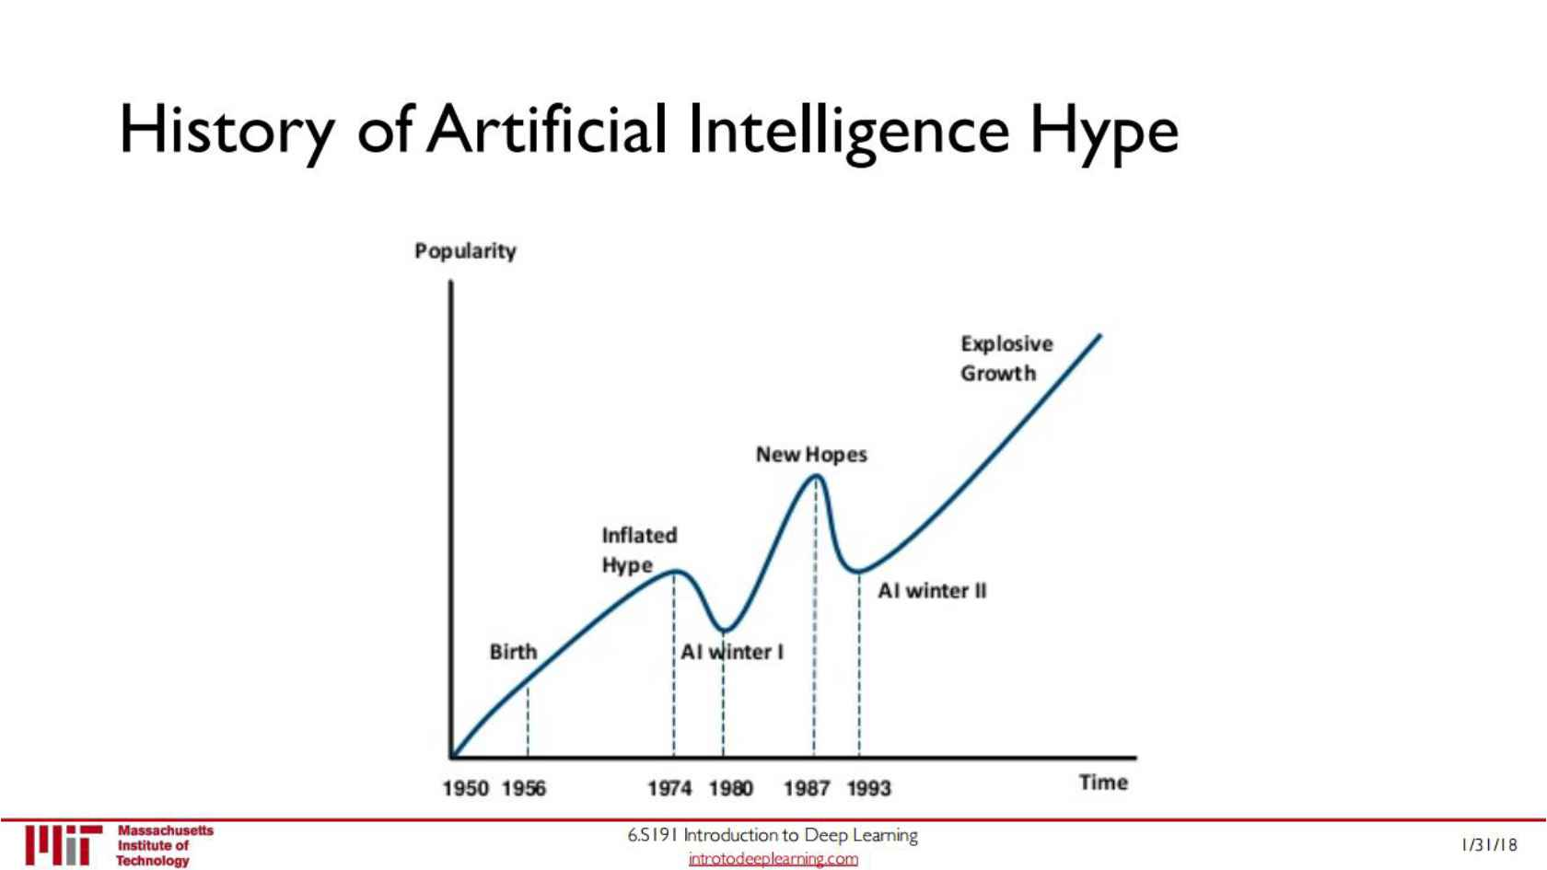
The come back!
AI gains scary effectiveness and pervasiveness
Excitement fades, certain apps benefit hugely
Bubble bursts, next AI winter arrives
Today
Notes:
Ajouter une photo d’un vieux telegraphe, puis un mobile satellitte ancienne generation…can someone find an even older wireless communication system (smoke)

Slide 17
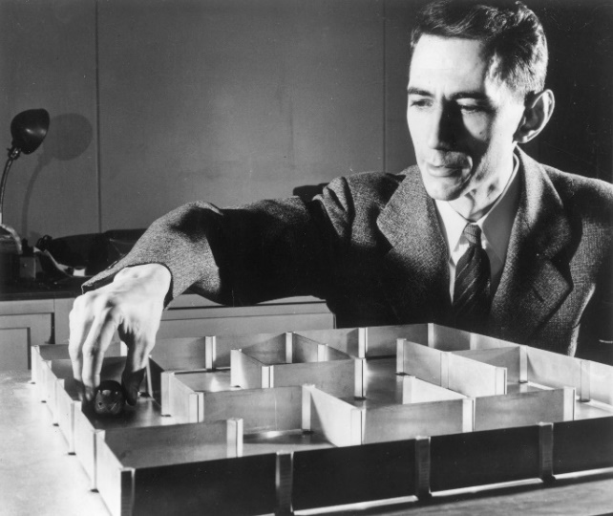
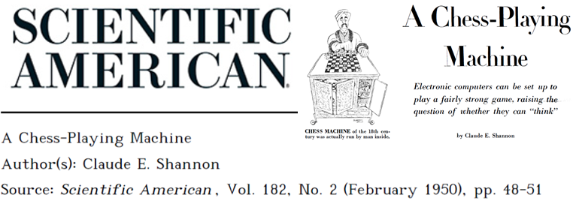
Is AI/ML new in Telecom?
Claude Shannon (1916 –2001)
Notes:
Ajouter une photo d’un vieux telegraphe, puis un mobile satellitte ancienne generation…can someone find an even older wireless communication system (smoke)

Slide 18
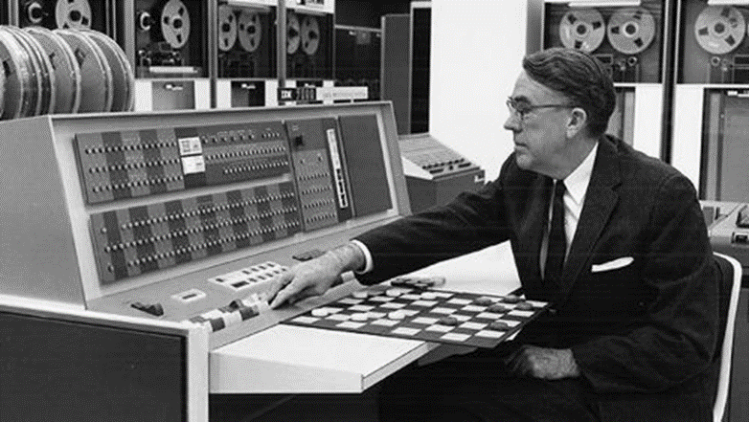

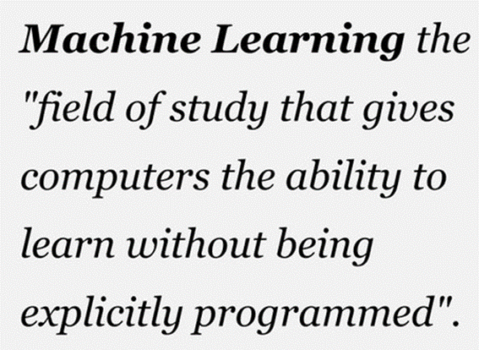
Paving the way to AI
L. Samuel, "Some Studies in Machine Learning using the Game of Checkers,"
IBM Journal of Research and Development, vol. 3, no. 3, pp. 210-229, July 1959
Probably the very first time the term “Machine Learning” appeared in print !
Notes:
Ajouter une photo d’un vieux telegraphe, puis un mobile satellitte ancienne generation…can someone find an even older wireless communication system (smoke)

Slide 19
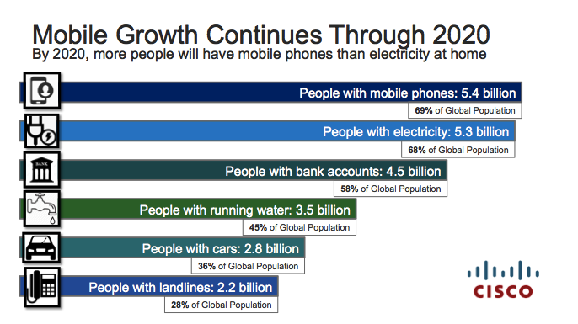
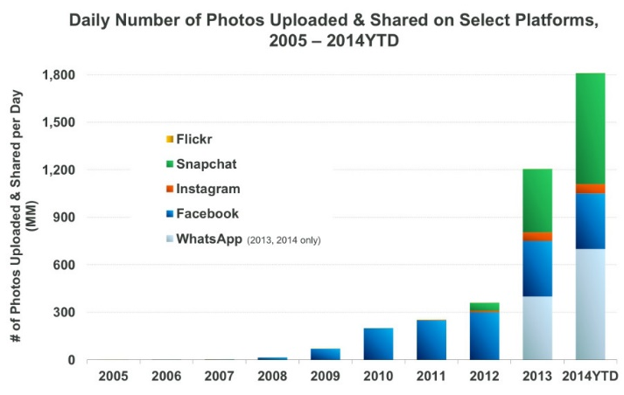
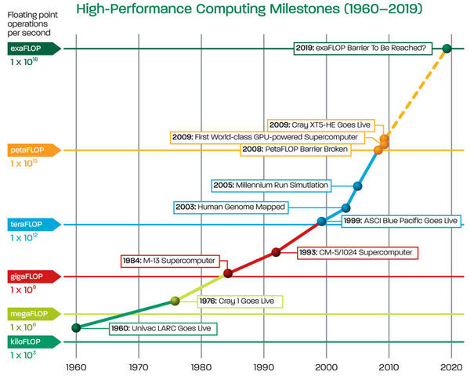
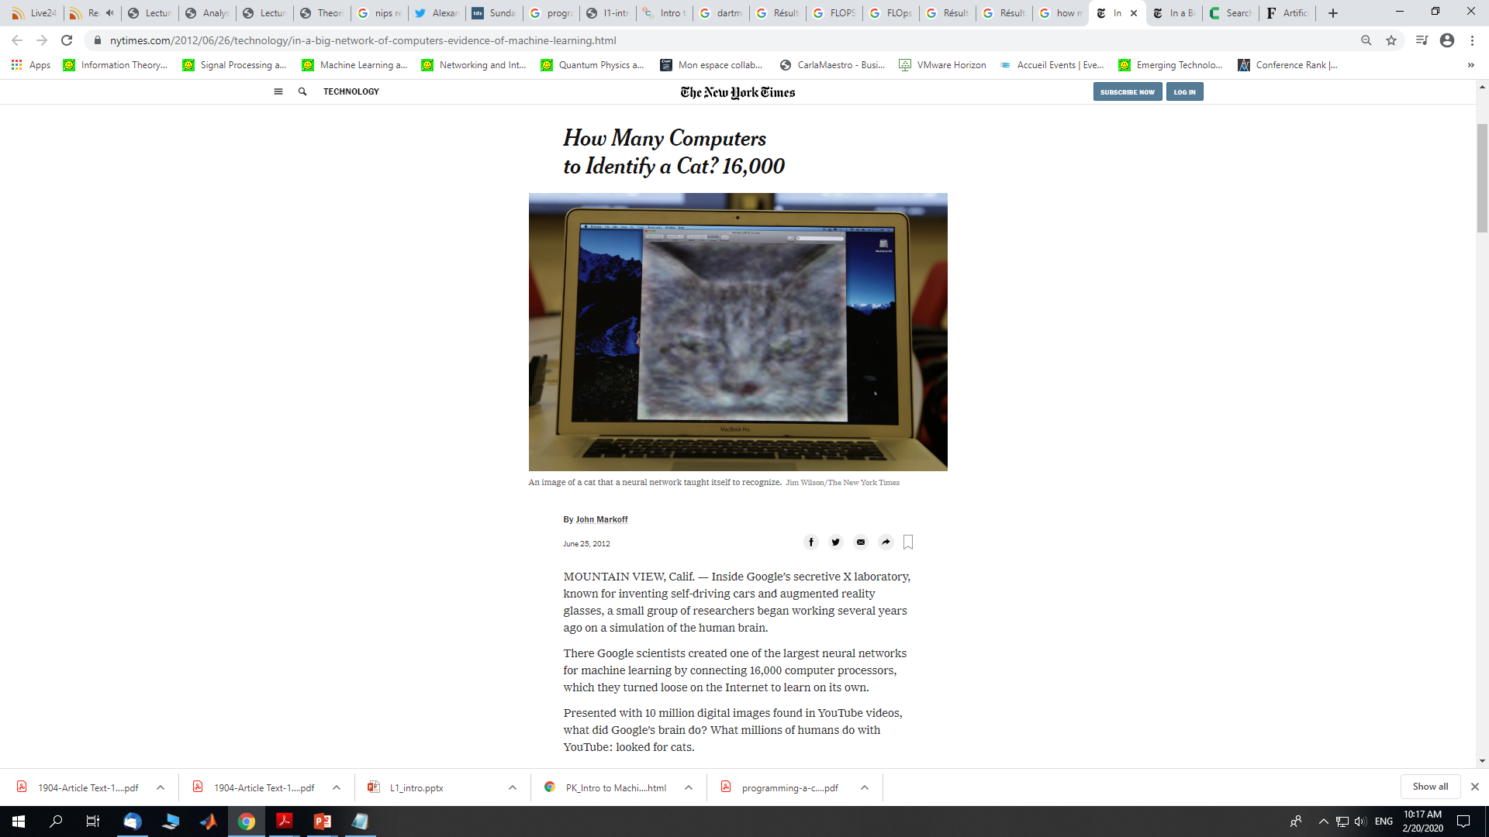
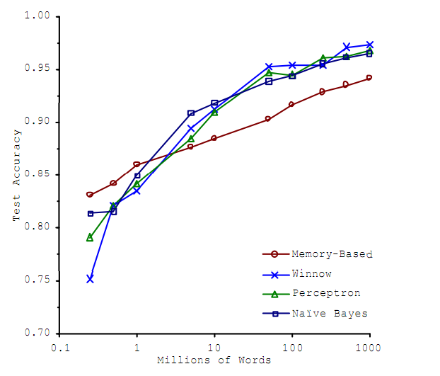
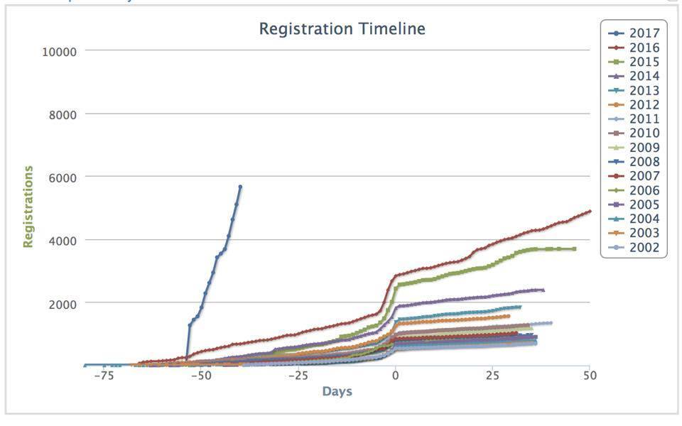
Why Now? What has changed?
Source: KPCB
1950s: 103 FLOPS
2017: 1017 FLOPS
Source: AMD
Increased computational power
Data everywhere!
Better algos/models/SW tools
NeurIPS
Source: Banko & Brill, 2011
Notes:
Ajouter une photo d’un vieux telegraphe, puis un mobile satellitte ancienne generation…can someone find an even older wireless communication system (smoke)

Slide 20
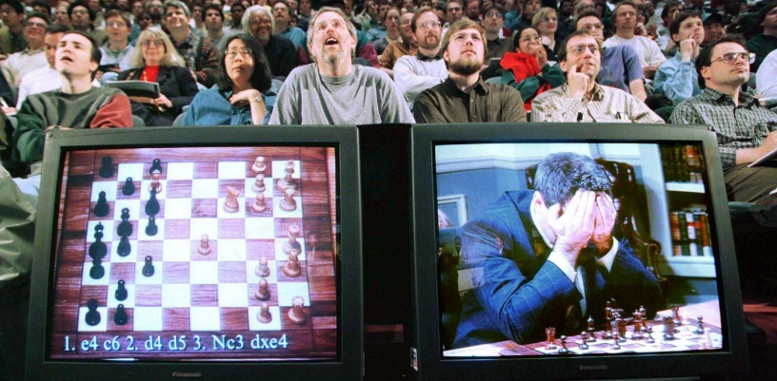
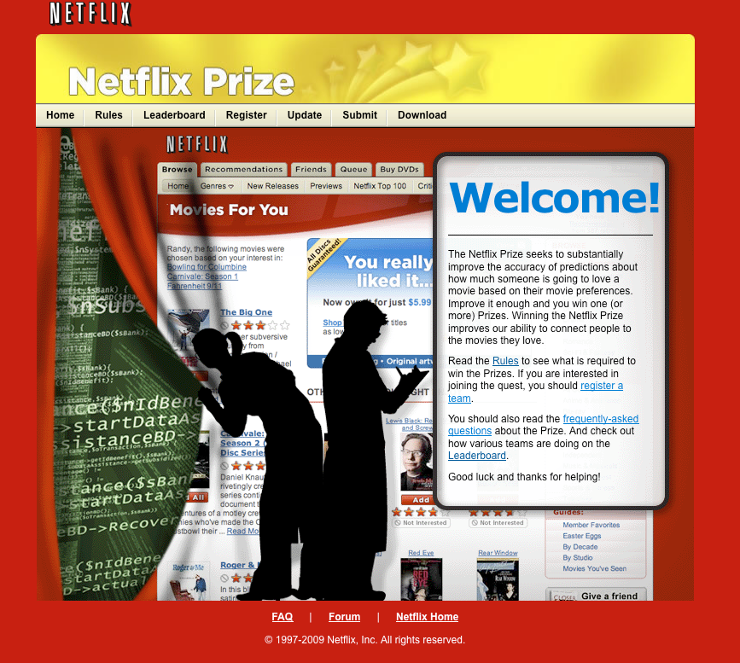
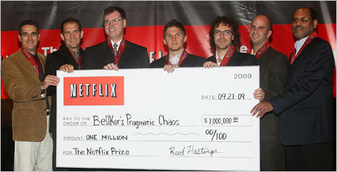
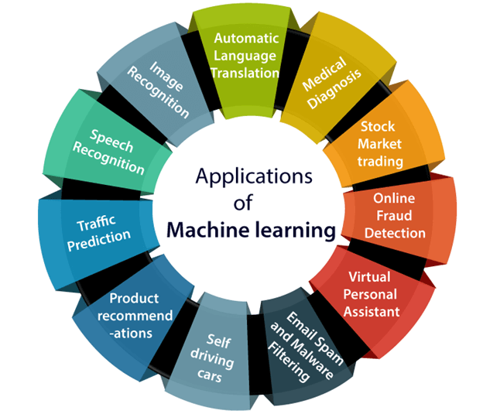
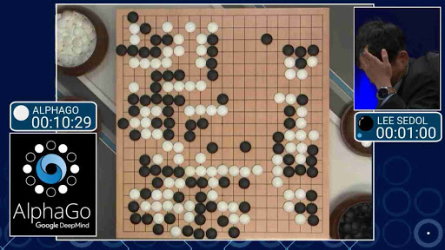
Buzz & Apps
Netflix Challenge (Sept. 2009)
Goal: Predict how a viewer will rate a movie
10% improvement = 1 million $
Deep Blue vs. Kasparov (May 11, 1997)
AlphaGo vs. Lee Sedol (March 2016)
Reaching human level performance
Notes:
Ajouter une photo d’un vieux telegraphe, puis un mobile satellitte ancienne generation…can someone find an even older wireless communication system (smoke)

Slide 21
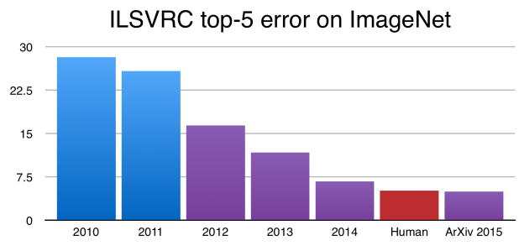
The Role of CTF
Common Task Framework
Comprehensive dataset framework for evaluating data-driven methods and their performance
Very successful in the Computer Vision and Speech Recognition communities where AI/ML has had transformative impact.
Publicly available training dataset: for each observation, a list of (possibly many) feature measurements, and a class label for that observation.
Set of enrolled competitors whose common task is to infer a class prediction rule from the training data.
Scoring referee, to which competitors can submit their prediction rule.
Some examples
Netflix Challenge (2009)
Kaggle (2010)
Fei-Fei Li ImageNet (2008-2010)
Hinton’s Deep Learning Team wins ImageNet 2012
Notes:
Ajouter une photo d’un vieux telegraphe, puis un mobile satellitte ancienne generation…can someone find an even older wireless communication system (smoke)

Slide 22
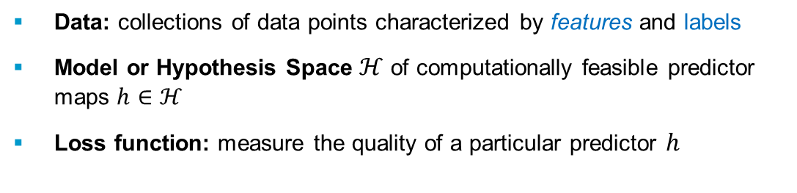
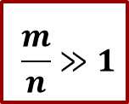
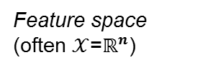
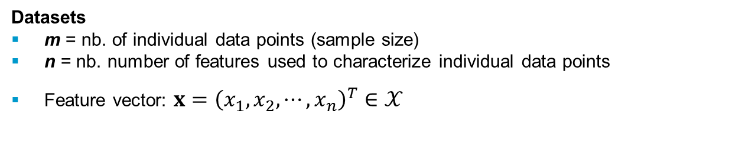
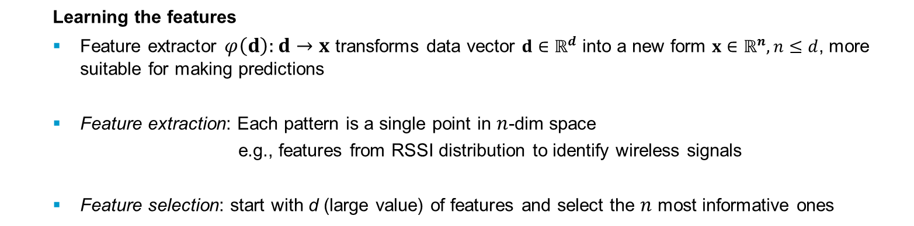
Main Components
Data: collections of data points characterized by features and labels
Model or Hypothesis Space $ℋ$ of computationally feasible predictor maps $h∈ℋ$
Loss function: measure the quality of a particular predictor $h$
Data
Model
Datasets
m = nb. of individual data points (sample size)
n = nb. number of features used to characterize individual data points
Feature vector: $x={\left(x_{1},x_{2},⋯,x_{n}\right)}^{T}∈𝒳$
Loss
$$\frac{m}{n}≫1$$
Feature space (often $𝒳$=$ℝ^{n}$)
Learning the features
Feature extractor $φ\left(d\right):d→x$ transforms data vector $d∈ℝ^{d}$ into a new form $x∈ℝ^{n}, n≤d$, more suitable for making predictions
Feature extraction: Each pattern is a single point in $n$-dim space
e.g., features from RSSI distribution to identify wireless signals
Feature selection: start with d (large value) of features and select the $n$ most informative ones
Notes:
Ajouter une photo d’un vieux telegraphe, puis un mobile satellitte ancienne generation…can someone find an even older wireless communication system (smoke)

Slide 23





Simple Example
color
{Tasty / Not Tasty}
softness
Domain set, $𝒳$: This is the set of objects that we may wish to label.
Label set, $𝒴$: The set of possible labels.
A prediction rule, $h :𝒳→𝒴$: used to label future examples.
This function is called a predictor, a hypothesis, or a classifier.
$𝒳$: set of all papayas. Vector of features to represent the domain points (instances): color and softness.
$𝒴=\{0,1\}$: 0 for tasty, 1 not tasty
$h$: rule to examine future papayas.
Notes:
Ajouter une photo d’un vieux telegraphe, puis un mobile satellitte ancienne generation…can someone find an even older wireless communication system (smoke)

Slide 24





Baseline ML Approach
Unknown target function $f(x)$
Goal: perform well on unseen data
Test data
Measure performance
Training data
$$x∈ℝ^{n}$$
Learning algorithm
Trained model
$$\hat{f}(x;θ^{∗})$$
Parametric model
$$\hat{f}(x;θ)$$
Notes:
Ajouter une photo d’un vieux telegraphe, puis un mobile satellitte ancienne generation…can someone find an even older wireless communication system (smoke)

Slide 25

ML Pipeline
Problem definition
Data collection
Data preparation / Pre-processing
Various challenges and design choices
Millions of examples, TBs or PBs of raw data
How much data is enough?
What kind of data to collect?
Training on ImageNet takes day(s)
Architecture vs. weights
Throw more data?
Go deeper?
Comp. demanding models
Performance guarantees
Confidence
Generalization
Explainability
Interpretability
Fairness
Notes:
Ajouter une photo d’un vieux telegraphe, puis un mobile satellitte ancienne generation…can someone find an even older wireless communication system (smoke)

Slide 26


Training vs. Inference
TRAINING
INFERENCE
Source: NVIDIA
Notes:
Ajouter une photo d’un vieux telegraphe, puis un mobile satellitte ancienne generation…can someone find an even older wireless communication system (smoke)

Slide 27


Taxonomy of Machine Learning
Supervised learning
Training data includes desired outputs
Dataset comprised of labeled examples (a pair $(x,y)$)
Unsupervised learning
Training data does not include desired outputs
Find structure in some examples (there are no labels!)
Weakly/Partially/Semi-supervised learning
Training data includes a few desired outputs
Reinforcement learning
Rewards from sequence of actions
Feedback-based sequential decision making (decisions, not only prediction)
Supervised
Unsupervised
Reinforcement learning
Notes:
Ajouter une photo d’un vieux telegraphe, puis un mobile satellitte ancienne generation…can someone find an even older wireless communication system (smoke)

Slide 28
Tasks
Supervised Learning
x
Classification
y
discrete labels
x
Regression
y
continuous labels
Unsupervised Learning
x
Clustering
y
discrete ID
x
Dimensionality Reduction
y
continuous
Reinforcement Learning
x
Reinforcement Learning
actions
Learning from feedback
Notes:
Ajouter une photo d’un vieux telegraphe, puis un mobile satellitte ancienne generation…can someone find an even older wireless communication system (smoke)

Slide 29
Taxonomy of Machine Learning
Passive vs. Active
Passive learner is given the training examples
Active learner can affect the choice of training examples on the basis of prior observations.
Active learner first reasons about which examples would be most useful for training (taking as few examples as possible) and then collects those examples.
Online vs. Offline
Offline learning (batch processing) operates over a batch of training samples
Allows for more involved ML based on all available data
High convergence speed
Not suitable for real-time learning of rapidly fluctuating processing
Online learning processes samples in a streaming fashion (stream of data instances arriving sequentially).
“On-the-fly” scheme, memory-efficient, highly scalable
Slow convergence speed
Notes:
Ajouter une photo d’un vieux telegraphe, puis un mobile satellitte ancienne generation…can someone find an even older wireless communication system (smoke)

Slide 30
Taxonomy of Machine Learning
Notes:
Ajouter une photo d’un vieux telegraphe, puis un mobile satellitte ancienne generation…can someone find an even older wireless communication system (smoke)

Slide 31
Discriminative vs. Generative Models
Discriminative
Only care about estimating the conditional probabilities
Very good when underlying distribution of data is really complicated (e.g. texts, images, movies)
Generative
Model observations $(x,y)$ first
Then infer $p(y|x)$
Good for missing variables, better diagnostics
Easy to add prior knowledge about data
Notes:
Ajouter une photo d’un vieux telegraphe, puis un mobile satellitte ancienne generation…can someone find an even older wireless communication system (smoke)

Slide 32


Generative Models
Given training data, how to generate new samples from the same distribution
1) Collect a large amount of data (e.g., millions of images, sentences, or sounds, etc.)
2) Train a model to generate data like it.
Intuition: “Whatever I cannot create, I do not understand” (R. Feynman)
Real Images (ImageNet)
Generated Images
https://openai.com/blog/generative-models/
Notes:
Ajouter une photo d’un vieux telegraphe, puis un mobile satellitte ancienne generation…can someone find an even older wireless communication system (smoke)

Slide 33

“Magic” of Generative Models
Which one is Computer generated?
SRGAN: arXiv:1609.04802
Notes:
Ajouter une photo d’un vieux telegraphe, puis un mobile satellitte ancienne generation…can someone find an even older wireless communication system (smoke)

Slide 34


Applications
Single image Super-resolution
Image denoising, photo inpainting, photo blending, structured prediction, semantic-Image-to-Photo translation, exploration in RL, NN pretraining….
Image to image translation
(Ledig et al. 2016)
Creating Art (GANGogh)
Human Face Generation (StyleGAN)
(Isola et al. 2016)
Notes:
Ajouter une photo d’un vieux telegraphe, puis un mobile satellitte ancienne generation…can someone find an even older wireless communication system (smoke)

Slide 35
ML Algorithms: from Theory to Practice
Fundamental issues
Concentration of measure: high-dimensional problems are remarkably predictable
Curse of dimensionality: without structure, many problems are hopeless
Low-dimensional structure is essential
ML brings in algorithmic components
Computational constraints are central – Finite computation, time, memory, bandwidth
Memory constraints: need for distributed and decentralized procedures
Increasing importance of privacy
Efficient algorithms are essential
only (low-order) polynomial-time methods can ever be implemented
trade-offs between computational complexity and performance?
fundamental barriers due to computational complexity?
Distributed processes are often needed
modern data sets too large to be stored on a single machine
need for methods that operate separately on pieces of data
trade-offs between decentralization and performance?
fundamental barriers due to communication complexity?
Privacy and access issues
conflicts between individual privacy and benefits of aggregation?
Notes:
Ajouter une photo d’un vieux telegraphe, puis un mobile satellitte ancienne generation…can someone find an even older wireless communication system (smoke)

Slide 36
ML in Communication Systems
Why relevant?
Taming network complexity (optimum is computationally infeasible)
Lack of neat models amenable to analysis (model deficit)
Reducing complexity (algorithm deficit)
Exploiting large datasets
Potential applications
PHY: estimation/prediction, receivers, coding
MAC/RRM: random access, dynamic spectrum access (DSA), handover, admission control, power control
NET: planning, fault identification/self-healing, scheduling
When to use it?
Traditional engineering flow not applicable or inadequate:
model deficit: a physics-based model is not available
algorithm deficit: a model is available, but optimal or near-optimal algorithms are not known or too complex to implement
Large data sets exist or can be created
Task does not require detailed explanations for how the decision was made
Task does not have stringent optimality requirements
Monte Carlo for algorithm deficit and generalization bounds for model deficit
Phenomenon or function being learned does not change rapidly
Notes:
Ajouter une photo d’un vieux telegraphe, puis un mobile satellitte ancienne generation…can someone find an even older wireless communication system (smoke)

Slide 37
What can ML do for ComSys?
Enable us to cope with a massively increasing complexity
Close gap or diminish mismatch between model and reality
Improve performance
Augment existing models/algorithms
Joint optimization of isolated problems
Facilitate self-organizing networks (cognitive network management)
Provide robust predictions (QoS, anticipatory networking)
….
Potential challenges
Easy access to (qualitative) data
Inference at PHY layer speed
Hardware implementation & On-Device: Model compression, quantization, pruning
Fast adaptation to changes: online learning, fine tuning
Cost of implementation vs. benefits
Notes:
Ajouter une photo d’un vieux telegraphe, puis un mobile satellitte ancienne generation…can someone find an even older wireless communication system (smoke)

Slide 38

Deep Learning in ComSys
What might change the picture?
Energy efficiency
Domain knowledge
Choice of performance metrics
Amount of training data
Andrew Ng
Lower Layers (PHY/MAC)
Collection of training data is limited
Fast time-varying channels and interference
Short stationarity interval (V2X: 10-40ms)
Distributed data
Limitations on computational power/energy
Higher Layers
Huge datasets are available but
Incomplete data (missing measurements for long periods)
Erroneous data (e.g. software bugs)
Misaligned data (different times)
Time series (i.i.d. unrealistic)
Notes:
Ajouter une photo d’un vieux telegraphe, puis un mobile satellitte ancienne generation…can someone find an even older wireless communication system (smoke)

Slide 39
ML in ComSys
Potential advantages
lower cost and faster development
if collecting data is less expensive/quicker than acquiring a physics-based model or an optimal algorithm
reduced implementation complexity
if hypothesis class contains low-complexity machines
Potential Disadvantages
Training & Labeled data (overhead & availability)
Robust performance (worst-case)
suboptimal performance and limited performance guarantees
Can we explain our decisions? Limited interpretability
Generalization
Algorithm/System interoperability
Independent training (e.g., UE with different capabilities)
Wireless systems are complex, not easy to define goal function and metrics
(NR radio access has more than 1000 configurable parameters per UE)
Notes:
Ajouter une photo d’un vieux telegraphe, puis un mobile satellitte ancienne generation…can someone find an even older wireless communication system (smoke)

Slide 40


The Problem of Complexity in Wireless
Degrees of Freedom in wireless systems are expanding
Antennas, channels, bands, codes, bandwidths, beams, modes, …
Types and effects of impairments continue to grow
Rising noise floor, sources of interference, hardware imperfections,…
Spectrum environment and channel models are more difficult
Number of devices, dense urban environments, unlicensed operation, etc.,
Number of vectors for optimization is steadily increasing
Dynamic radio behaviors, power usage (at both UE and BS), throughput, latency,…
Challenges in Wireless Broadband
Make Wireless 5G+ and IoT Scale
Increase Device Performance and Density
Drastically reduce power consumption & device cost
Real Time Wireless Analytics
Recognize device failures & wireless cyber attacks
Learn from pattern of life, identify threats, anomalies
Minimize cost and engineering time
Optimize Radio System Deployments
Efficient planning of 5G, LTE-U & IoT
Intelligent spectrum sharing strategies
Deployable Software Capabilities
Cloud managed infrastructure & optimization
Notes:
Ajouter une photo d’un vieux telegraphe, puis un mobile satellitte ancienne generation…can someone find an even older wireless communication system (smoke)

Slide 41

Coping with Wireless Complexity (or Not?)
Complexity creates an extremely difficult design/optimization problem !
Tools and methods for designing and optimizing wireless systems have not scaled with the problem complexity.
Today systems are designed & optimized in modular/piecemeal fashion and then glued together.
This approach precludes end-to-end optimization
Often requires simplified world models within each module
Both result in sub-optimal solutions to todays communications systems
Trend: End-to-End Learning/Optimization …using real-world data instead of toy models
Would that solve the problem ??
Notes:
Ajouter une photo d’un vieux telegraphe, puis un mobile satellitte ancienne generation…can someone find an even older wireless communication system (smoke)

Slide 42
Big Data in Wireless Networks
Wireless data
Generated by wireless users
Useful info about activity patterns vs. frq, time, space (“radio map”)
Can be used to infer
Traffic/demand variation over time
Interference levels at different frequencies
Congestion at different locations
Can be exploited for proactive resource management, network planning,…
Cloud data
Generated by streaming/download of content
Similarities and correlation in users’ preferences
Can be used to infer content popularity distribution, predict future demands
Can be exploited for proactive caching
Social data
Generated by social media
Rich info on context, preferences of individuals or social groups
Can be used to predict user behavior, context-aware networking
Can be exploited for market ads
Data driven vs. Data-informed approach
Notes:
Ajouter une photo d’un vieux telegraphe, puis un mobile satellitte ancienne generation…can someone find an even older wireless communication system (smoke)

Slide 43

Emerging Wireless Network Architectures
Cloud data
NET: Mobility patterns, network-wide traffic statistics, outage rates
APP: User’s behavior patterns, subscription information, service usage statistics, TCP/IP traffic statistics
Edge data
PHY: Baseband signals, (multi-RAT) channel quality
MAC/ Link: Throughput, FER, random access load and latency
NET: Location, traffic loads across services, users’ device types, battery levels
APP: Users’ preferences, content demands, computing loads, QoS metrics
Notes:
Ajouter une photo d’un vieux telegraphe, puis un mobile satellitte ancienne generation…can someone find an even older wireless communication system (smoke)

Slide 44

Big Data 4V’s
Source: NVIDIA
Notes:
Ajouter une photo d’un vieux telegraphe, puis un mobile satellitte ancienne generation…can someone find an even older wireless communication system (smoke)

Slide 45



Wireless Ecosystem Evolution & Trends
Emerging Cyber-Physical and Mission-Critical Interactive Systems
The Rise of Machines: swarm robotics, self-driving vehicles, smart IoT, …
Networked Apps & Services: reliable real-time communication, autonomous interactions, automated timely decision making in a sense-compute-actuate cycle
IoT
Notes:
Ajouter une photo d’un vieux telegraphe, puis un mobile satellitte ancienne generation…can someone find an even older wireless communication system (smoke)

Slide 46


Pressing Extreme Demands
From Connected Things to Connected Intelligence
6G = Wireless for Intelligent Machines
6G Wireless should support the needs of networked intelligent systems
Viatech.com
Do we know how to do it? Are we equipped necessary theory & algos?
Notes:
Ajouter une photo d’un vieux telegraphe, puis un mobile satellitte ancienne generation…can someone find an even older wireless communication system (smoke)

Slide 47






The Communication Problem
$$x$$
$$y$$
Channel
$$s$$
Transmitter
Receiver
$$\hat{s}$$
Goal: minimize $ℙ(\hat{s}≠s)$
$s∈ℳ=\left\{1,…,M\right\}, k=\log_{2}{M}$
$x∈ℂ^{n}$ with $𝔼\left[{\left\|x\right\|}^{2}\right]≤n$
$y∈ℂ^{n}\sim p(y|x)$
$\hat{s}∈ℳ$
Rate: $R=\frac{k}{n}$ bits/channel use

Slide 48
The Communication Problem
Physical channel model
Mismatched
$$x$$
$$y$$
Channel
$$s$$
Transmitter
Receiver
$$\hat{s}$$
2. Modular block structure
Sub optimal
...
...
...
...
Coding
Modulation
Synchro
Equalization

Slide 49
Fundamental Limits
Extremely close for point-to-point channels (linear channels)
Channel capacity not fully known in most wireless channels
Channels without models: mmWave, THz
Time-varying channels.
Channels with interference or relays.
Cellular systems
Ad hoc and sensor networks
Channels with delay/energy/€€€ constraints
Shannon limit definition
LDPC codes
R. Gallager
Turbo codes
C. Berrou & A. Glavieux
LDPC codes
rediscovered
MacKay & Neal
LDPC Codes
S.Y.Chung et al.
Polar Codes
E. Arikan
E_{b}/N₀ = -1.59 dB
0.7 dB
0.0045 dB
~ 0.000 dB
1948
1963
1993
1996
2001
2009

Slide 50










End-to-End Deep Communication
Neural Network
Neural Network
$$x$$
$$y$$
Channel
$$s$$
$$\hat{s}$$
$$f:ℳ→ℂ^{n}$$
$$x∈ℂ^{n}$$
$$y∈ℂ^{n}$$
$$g:ℂ^{n}→ℳ$$
$$\hat{s}∈ℳ$$
$s∈$ $ℳ$
Transmitter
Channel
Receiver
Learn a robust message representation
Trainable from end-to-end to minimize $ℙ(\hat{s}≠s)$
Universal concept that applies to any channel $p(y|x)$

Slide 51



The Communication Problem
1
2
3
C. Shannon. A mathematical theory of communication. Bell System Technical Journal, 27:379-423, 625-56, 1948.
(1) Reliable transfer of information
Shannon’s model
(2) No semantics
dichotomy between
information quantity
and meaning (content)
(3) Encoder and decoder centrally/jointly designed
Lore: theory of information quantity, but not of information content
Focus on “noise” (and “equivocation”) rather than “signal”
Suitable and instrumental for classical human-generated data communication

Slide 52


The General Problem
C: Effectiveness
Weaver’s model
(effectiveness factors)
B: Semantic
Local
Knowledge
Shared
Knowledge
Local
Knowledge
SEMANTIC
TRANSMITTER
SEMANTIC
RECEIVER
SEMANTIC
NOISE
A: Technical
Shannon’s model
Syntactic level
Semantic level
Pragmatic level

Slide 53

Information vs. Data
Information: ubiquitous, pervasive in our lives …. yet elusive!
Physical (Rolf Landauer) vs. not physical (John von Neumann)
Relation to data and knowledge
Bellinger 1996
Practical view
concentrates probability of possible outcomes
(when a potential outcome is not known with certainty)
affects estimates, uncertainties about estimates, or decisions (meaningful content)
Allows for quantification of the amount of informational content
Notes:
Ajouter une photo d’un vieux telegraphe, puis un mobile satellitte ancienne generation…can someone find an even older wireless communication system (smoke)

Slide 54










Précis of Information
Fisher Information (1927)
Amount of information RV $X$ carries about $θ$
$$ℐ\left(θ\right)=𝔼\left[\frac{∂}{∂θ}\log{f\left(X;θ\right)|θ}\right]$$
N. Wiener
L. Brillouin
D. Gabor
D. MacKay
F. Dretske
…
F. Dretske
B. Skyrms
C.F. von Weizsäcker
J. Barwise
D. Nauta
…
Algorithmic Information
(Kolmogorov, Chaitin, Solomonoff)
Complexity is the size of the smallest program $p$ on a universal Turing machine $U$ that generates object $x$
$K(x)=min⁡\{\left|p\right|:U(p)=x\}$
Shannon Information (1948)
measured by the statistical uncertainty reduction upon receipt of a message
$H\left(X\right)=−\sum_{x∈𝒳}{P(x)\log{P(x)}}$
Notes:
Ajouter une photo d’un vieux telegraphe, puis un mobile satellitte ancienne generation…can someone find an even older wireless communication system (smoke)

Slide 55


Information and Value
Information as uncertainty and surprise
Information gain – measuring the statistical uncertainty reduction upon receipt of a message
Operational meaning to entropy
$$H\left(X\right)=−\sum_{x∈𝒳}{P(x)\log{P(x)}}$$
$$I\left(X;Y\right)=H\left(Y\right)−H\left(Y|X\right)$$
Decision-making information
Used by agents, observers, and info generators to make improved decisions (incl. better inference, predictions, etc.)
Enable to select a course of action (or inaction) given all (known) possible choices of action
Value, utility, importance, goals - need for observer/receiver
Absolute vs. relative ? Objective vs. subjective ? Intrinsic vs. extrinsic ?
Notes:
Ajouter une photo d’un vieux telegraphe, puis un mobile satellitte ancienne generation…can someone find an even older wireless communication system (smoke)

Slide 56










Info Theory, Statistics, and ML
A rich intersection between information theory and statistics
Hypothesis testing, large deviations
Fisher information, Kullback-Leibler divergence
Metric entropy and Fano’s inequality
Channel: user observes n i.i.d. draws ${X_{i}\sim ℚ}_{θ^{∗}}$
Codebook: indexed family of probability distributions $\left\{ℚ_{θ} \right| θ∈Θ\}$
Codeword: nature chooses some $θ^{∗}∈Θ$
$$θ^{∗}$$
$$Θ$$
$$ℚ_{θ^{∗}}$$
$$X_{i}^{n}$$
$$\hat{θ}$$
Decoding: estimator $X_{i}^{n}↦\hat{θ}$ such that $\hat{θ}≈θ^{∗}$
Perspective dating back to Kolmogorov (1950s) with many variations:
Codebooks/codewords: graphs, vectors, matrices, functions, densities....
Channels: random graphs, regression models, elementwise probes of vectors/machines, random projections
Closeness $\hat{θ}≈θ^{∗}$: exact/partial graph recovery in Hamming, $ℓ_{p}$-distances, $L(ℚ)$-distances, sup-norm, etc.
Notes:
Ajouter une photo d’un vieux telegraphe, puis un mobile satellitte ancienne generation…can someone find an even older wireless communication system (smoke)

Slide 57

Distributed Learning System Model
Massively large distributed systems with individually small and unreliable computational nodes
“System noise” – anomalous system behavior and bottlenecks
System noise = latency variability (hard to predict)
Bottlenecks
Computation time
Communication load
Batch optimization
Coded: preprocessing, gradient coding
Uncoded: partial computations
Quantization/compression
Sparsification
Local parameter updates
Model compression /Pruning
Robust and Fast Edge Learning over Wireless Networks

Slide 58
The 3+1 Dimensions of ML Performance
Performance Tradeoffs
stat. accuracy
Our algorithms should be here
speed
parallelization
timeliness
Notes:
Ajouter une photo d’un vieux telegraphe, puis un mobile satellitte ancienne generation…can someone find an even older wireless communication system (smoke)

Slide 59

Machine Learning and Decision Making
ML uses (past) data to make personalized predictions
High-Stakes Decisions
Healthcare: What treatment to recommend to the patient?
Criminal Justice: Should the defendant be released on bail?
Accurate but interpretable, explainable, fair, trustworthy AI/ML
ML is being deployed in complex high-stakes settings: impact on human well-being
Accuracy alone is no longer enough
Auxiliary criteria are important:
Safety
Nondiscrimination/fairness
Right to explanation
Interpretability: how accurate an ML model can associate a cause to an effect. (HOW?)
Explainability: ability of the (hidden) parameters to justify the results (WHY?)
Notes:
Ajouter une photo d’un vieux telegraphe, puis un mobile satellitte ancienne generation…can someone find an even older wireless communication system (smoke)

Slide 60


Fairness and Algorithmic Bias
Facial analysis software:
Darker-skinned females are the most misclassified group (with error rates of up to 34.7%).
Maximum error rate for lighter-skinned males is 0.8% (higher accuracy).
[Buolamwini, Gebru 2018, proceedings.mlr.press/v81/buolamwini18a.html]
Notes:
Ajouter une photo d’un vieux telegraphe, puis un mobile satellitte ancienne generation…can someone find an even older wireless communication system (smoke)

